Slide 1
TEAM POLICY & PROJECT MANAGEMENT TOOLS
TEAM POLICY
All team members are required to attend online meetings when scheduled. If unavailable then inform prior to the meeting.
All team members must work on their tasks.
All team members must help each other.
All team members must communicate effectively to avoid confusions.
All team members must read the assignments, follow and complete the required tasks.
PROJECT MANAGEMENT TOOLS
Blackboard Collaborate
WhatsApp
Github
Google Slides
Lucidchart

Slide 2
MEETING LOG
Date & Time | Members Present | General Activity | Details
02/21/2022 | Charan, Debolina, Hitesh, Hrithik, Rhea | Brainstorming, splitting tasks | Discussed about team policy Discussed about the project requirements Divided tasks among team members
02/23/2022 | Charan, Debolina, Hitesh, Hrithik, Rhea | Presentation practice | Discussed about presentation Split slides among team members Practiced presentation to be delivered

Slide 3
TASKS of TEAM MEMBERS
Team Member | Task
Charan | Q1 and Q2, Write pseudocode for random search
Debolina | Q1 and Q2, Write pseudocode for linear search
Hitesh | Q1 and Q2, Write pseudocode for binary search
Hrithik | Write complexity analysis report
Rhea | Prepare team policy, requirement/planning, draw UML chart, analysis and output report

Slide 4
HI LO GAME DESIGN

Slide 5
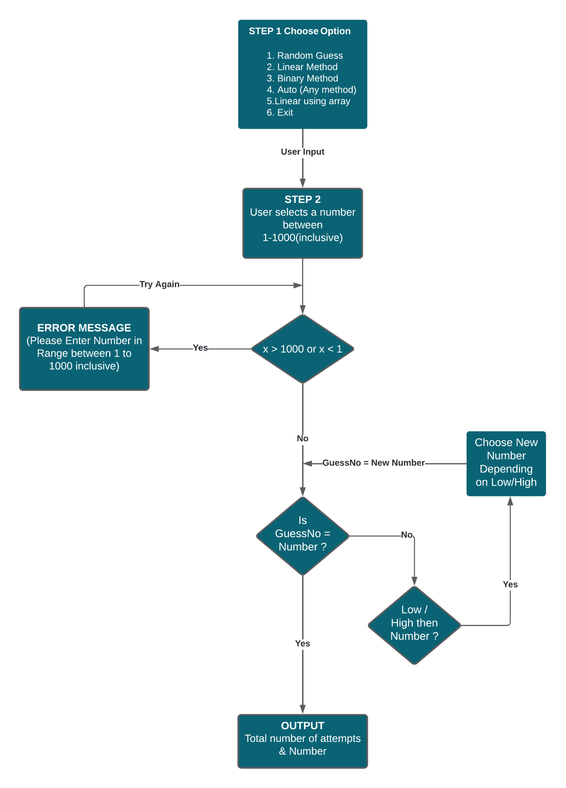

Slide 6
USE CASE DIAGRAM

Slide 7
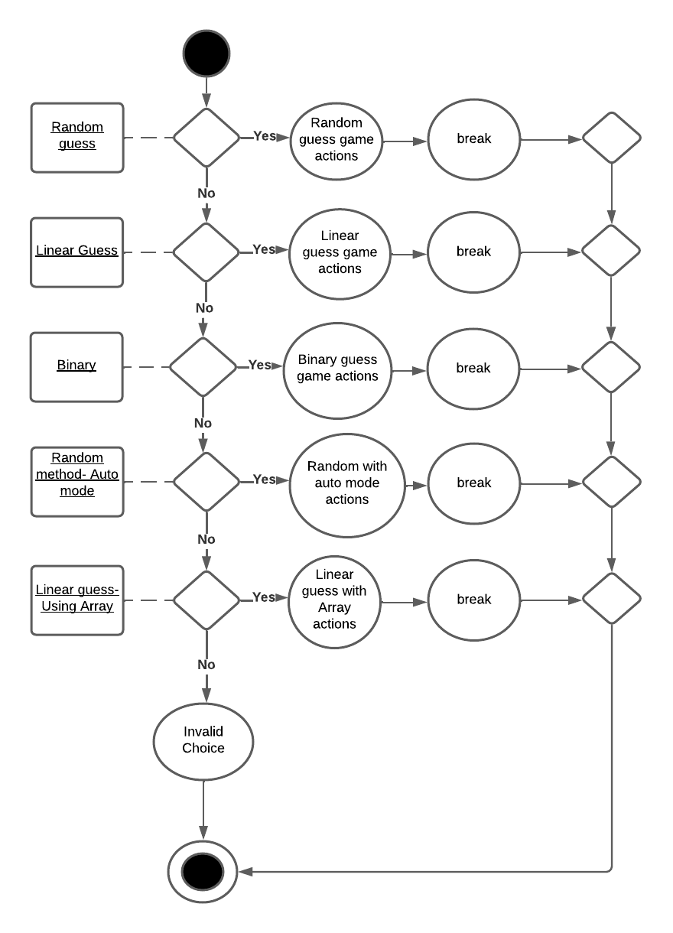
Notes:
Use case diagram- explanation- A use case diagram is used to represent the dynamic behavior of a system. It encapsulates the system's functionality by incorporating use cases, actors, and their relationships
Depicting a switch case
There are 5 switch cases here one default case at the bottom

Slide 8
PSEUDOCODE

Slide 9
RANDOM SEARCH
PSEUDO CODE
STEP 1: System chooses a random number from 1 to 1000 using random method
→ Start
Random Number←Chosen by system
Number←Chosen by user
Count/Guesses←0 (initialize count to 0)
STEP 2: Check if Number = Random Number
If TRUE then Step 4.
If FALSE then check the Number is HIgher / Lower and prompt to choose Lower / Higher Number. Increment Count = Count + 1
STEP 3: Continue Step 2 until Number = Random Number
STEP 4: Exit and Print number of Guesses/Count
→End

Slide 10
LINEAR SEARCH
PSEUDO CODE
STEP 1: Input a number from 1 to 1000 using user input
→ Start
Min ← 1
Max ←1000
Count ←0 (initialize count to 0)
Num ← Input from user
STEP 2: If Num is less than the minimum required condition and if the Num exceeds the Maximum given condition
Invalid Input
Check using “OR” condition num>max || Num<max
STEP 3: Increment the number of count by 1
Using if loop min<num
Increment Count until Min == Num
STEP 4: Exit and print out the total count when program guesses correctly
Print Count
→ End

Slide 11
BINARY SEARCH
PSEUDO CODE
STEP 1: Input a number from 1 to 1000 using user input
→ Start
Min ← 1
Max ←1000
Mid ← (high+low)/2
Counter ←0 (initialize count to 0)
Guess ← Input from user
randomNumber ← Random number generated using rand function
STEP 2: Check if randomNumber is equal to guess
STEP 3: Print the number and acknowledge the user if guessed correctly. Go to step 8
STEP 4: Go to step 5 if not guessed correctly.
STEP 5: Increment the counter.
STEP 6: If randomNumber is greater than guessed number and if randomNumber is less than mid then update high = mid else update low = mid. Ask user to guess again within the new range of low and high. Go to Step 2
STEP 7: If randomNumber is less than guessed number and if randomNumber is less than mid then update high = mid else update low = miD. Ask user to guess again within the range of low and high. Go to Step 2
STEP 8: Exit and print out the total attempts that user took to guess correctly.
→ End

Slide 12
OUTPUT ANALYSIS

Slide 13
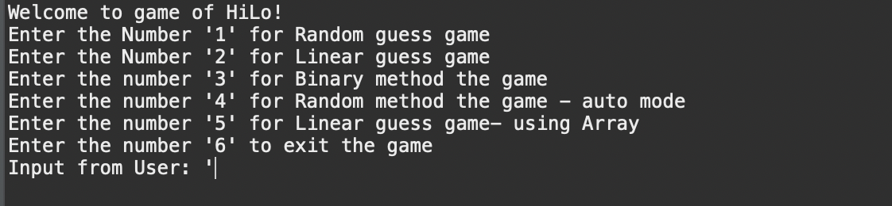
HILO GAME

Slide 14
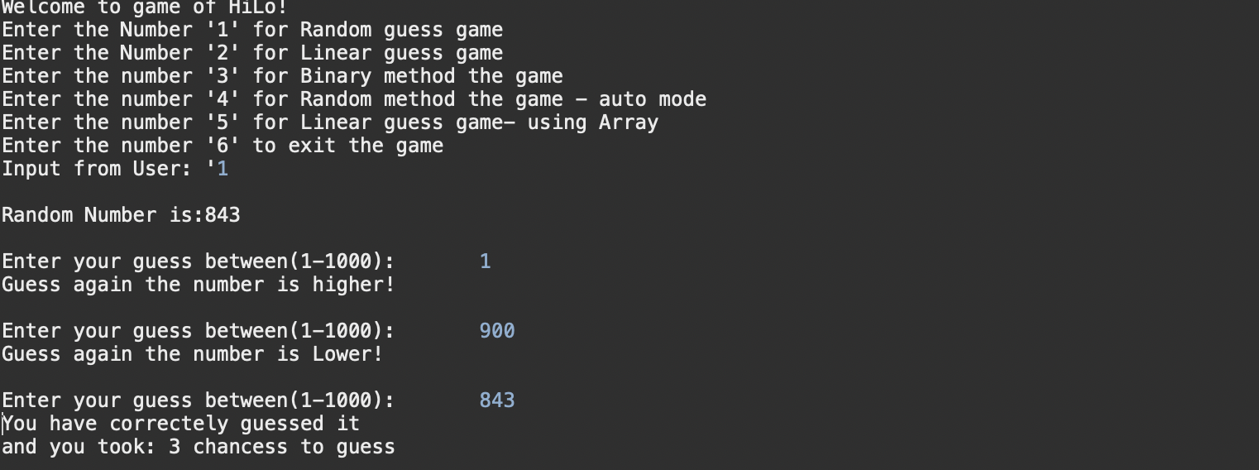
RANDOM SEARCH

Slide 15
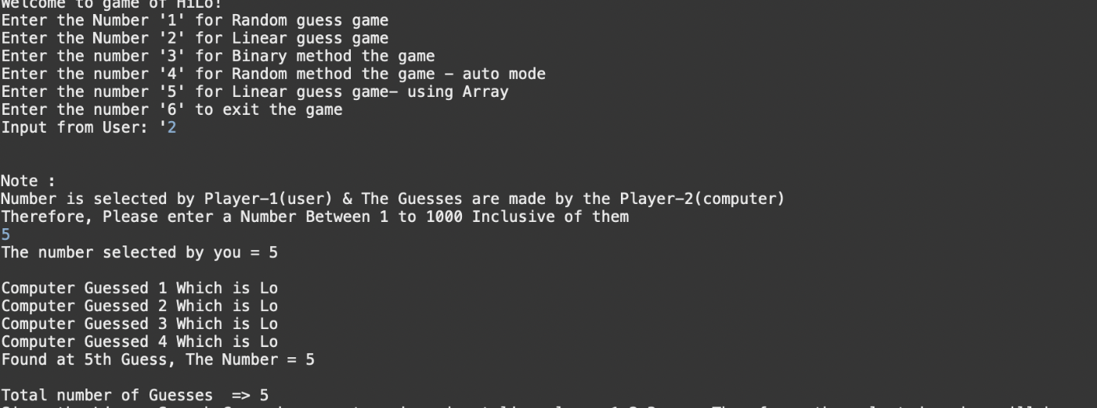
LINEAR SEARCH

Slide 16
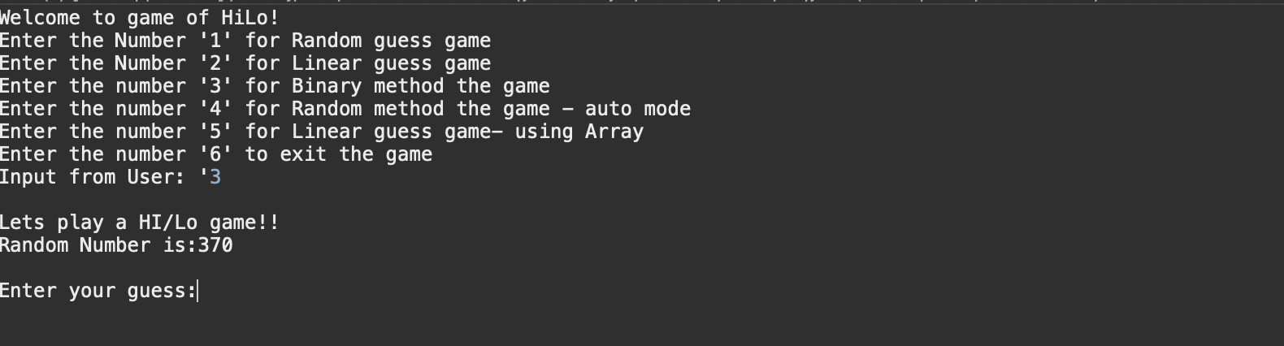
BINARY SEARCH

Slide 17
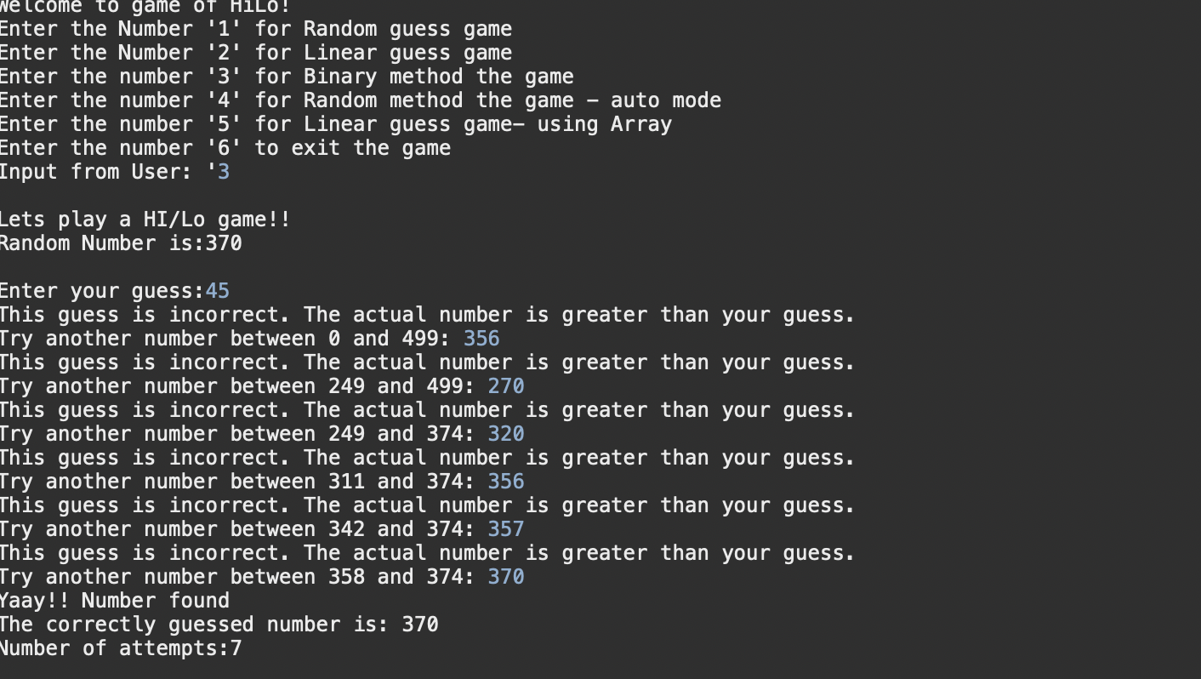
BINARY SEARCH

Slide 18
COMPLEXITY ANALYSIS

Slide 19
RANDOM SEARCH COMPLEXITY ANALYSIS
● Best case time complexity: When randomly choose an element and it comes out to be the desired element. In this situation, time complexity is constant, i.e., (1) time
● Worst case time complexity: When it takes infinite times to arrive to the correct number: infinite
● Average case time complexity: is random

Slide 20
LINEAR SEARCH COMPLEXITY ANALYSIS
Best Case time complexity: desired element is found at the first index. Constant time complexity, i.e. O(1)
Worst case time complexity: desired element is found at the last index. O(n)
Average time complexity: O(n)

Slide 21
BINARY SEARCH COMPLEXITY ANALYSIS
Best case time complexity: when central index directly matches the desired value, O(1).
Worst Case time complexity: O(log n).
Average time complexity: O(log n).
Binary search can be implemented as iterative or recursive.
Recursive mode has been used here.
The recursive approach has a complexity O(log n).

Slide 22
COMPLEXITY ANALYSIS REPORT
 | Random Search Complexity Analysis | Linear Search Complexity Analysis | Binary Search Complexity Analysis
Best Case | 1 | 1 | 1
Average Case | Random | O(n) | O(log n)
Worst case | Infinity | O(n) | O(log n)

Slide 23
QUESTIONS?

Slide 24
THANK YOU

